Slide 1
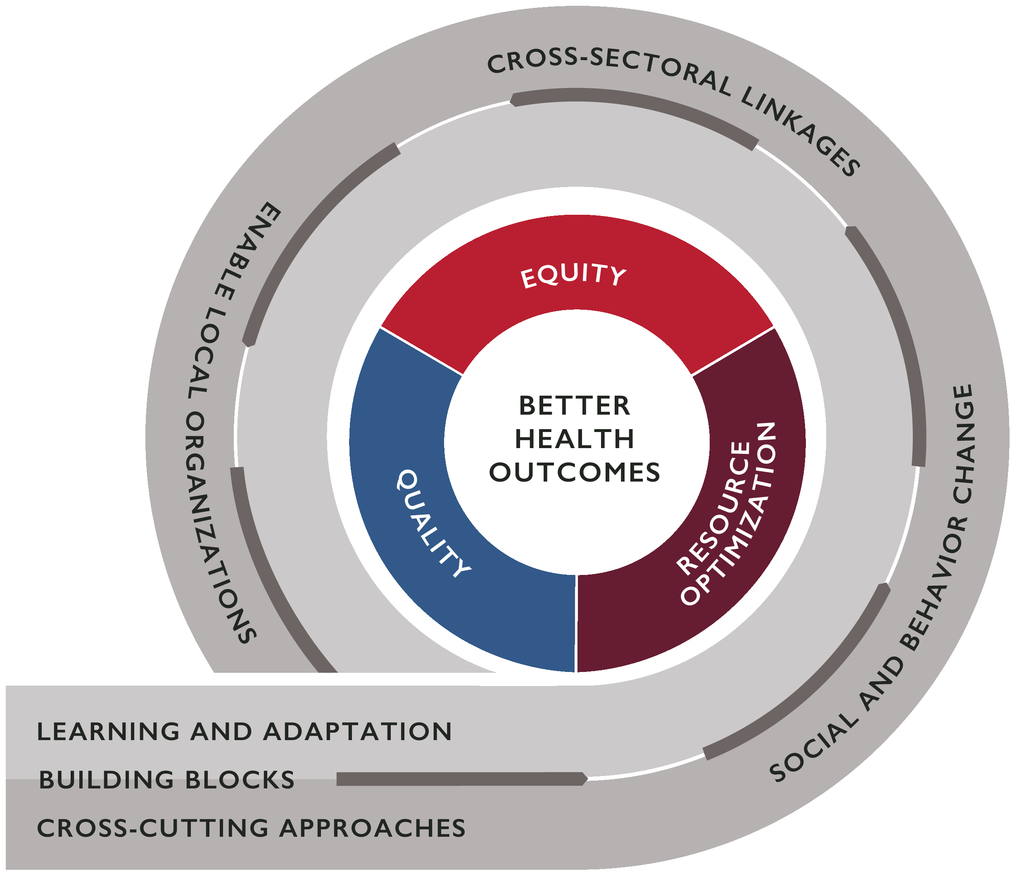
Learning Question 1: What are the contributions of systems thinking approaches and tools to changes in health system outcomes? How do systems thinking approaches affect health system outcomes?
Title
Author Names and Information
Include Organization or Department Names if Needed
Context
Describe the context in which the activity takes place. What is the health problem that you are trying to solve? What health system challenges contribute to this problem? Why did you decide to apply a health systems approach to this problem? Why did you choose this approach over others?
Activity Impact
How did this activity strengthen the health system? Which components of the health system did you act on (for example, did you support improvements in financing, cross-sectoral coordination, governance, local ownership, information, human resources, behavior of health system actors, service delivery, or medical products, vaccines, or technologies)? How did the pieces of your activity come together to impact equity, quality, and/or resource optimization in the health system? How did these improvements in equity, quality, and/or resource optimization lead to better health outcomes? How does this activity contribute to health system resiliency and/or sustainability?
Facilitators
What aspects of the health system, context, or external partner support helped make this successful? For example, were there existing working groups in place that enabled efficient coordination between stakeholders on this activity? Did you use a tool or knowledge resource from a global partner like WHO or UNICEF to help inform your activity?
Challenges
What were some problems or challenges that you faced during your activity implementation? Did you expect these challenges or were they unanticipated? How did you respond to these challenges?
Activity Description
Please describe what you are doing to address this health system challenge. What steps did you take to implement this activity? What government agencies or other stakeholders did you work with and how did you engage them? Did you make any changes to your approach as you went along and if so, why? Have you scaled up or do you have plans to scale up?
Evidence
What evidence do you have of your activity’s impact on health system or health outcomes? How can you best show what your activity accomplished? How do you know that you met your goals? Is the evidence able to be measured? Graphs or charts may be useful here to show this evidence.
Lessons Learned
What lessons have you learned while you implemented this activity? How will this impact future activities or approaches? What advice would you give to other implementers and health systems actors in other countries that might want to adapt your approach?

Slide 2
Learning Question 2: What conditions or factors successfully facilitate the institutionalization and/or implementation at scale of good practices that improve health system outcomes, and why? What are lessons learned regarding planning for sustainability and achieving results at scale?
Title
Author Names and Information
Include Organization or Department Names if Needed
Context
Describe the context in which the activity takes place. What is the health problem that you are trying to solve? What health system challenges contribute to this problem? How was the approach that you decided to institutionalize/scale up originally implemented? Why did you decide to institutionalize/scale it up?
Activity Impact
How did this activity strengthen the health system? Which components of the health system did you act on (for example, did you support improvements in financing, cross-sectoral coordination, governance, local ownership, information, human resources, behavior of health system actors, service delivery, or medical products, vaccines, or technologies)? How did the pieces of your activity come together to impact equity, quality, and/or resource optimization in the health system? How did these improvements in equity, quality, and/or resource optimization lead to better health outcomes? How does this activity contribute to health system resiliency and/or sustainability?
Facilitators
What aspects of the health system, context, or external partner support helped make this successful? For example, were there existing working groups in place that enabled efficient coordination between stakeholders on this activity? Did you use a tool or knowledge resource from a global partner like WHO or UNICEF to help inform your activity?
Challenges
What were some problems or challenges that you faced during your activity implementation? Did you expect these challenges or were they unanticipated? How did you respond to these challenges?
Activity Description
Describe in detail the process you used to scale up or institutionalize this approach. What government agencies or other stakeholders did you work with and how did you engage them? How did you build government/stakeholder ownership or buy-in? How was the scale-up or institutionalization funded? How did you ensure sustainability?
Evidence
What evidence do you have that the scale-up up or institutionalization of this approach was successful? How can you best show what your activity accomplished? How do you know that you met your goals? Is the evidence able to be measured? Graphs or charts may be useful here to show this evidence.
Lessons Learned
What lessons have you learned while you implemented this activity? How will this impact future activities or approaches? What advice would you give to other implementers and health systems actors in other countries that might want to adapt your approach?

