Slide 1
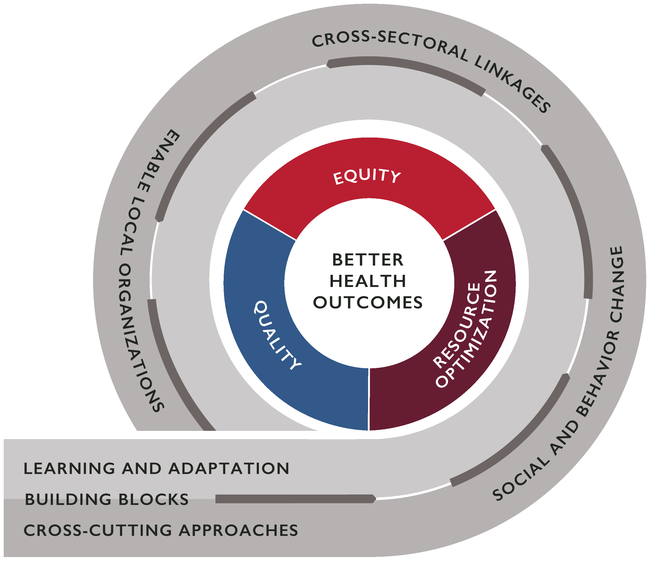
Question 1: How have systems thinking approaches and tools been incorporated in activities to improve health equity? Were these approaches useful in achieving health equity goals? If so, what are the pathways by which these approaches helped to address the root causes of inequity?
Title
Author Names and Information
Include Organization or Department Names if Needed
Context
Describe the context in which the activity takes place. What is the health equity problem that you are trying to solve? What are the root causes of this equity problem, from your understanding? Why did you decide to apply a health systems approach to this problem? Why did you choose this approach over others?
Activity Impact
How did this activity improve health equity, or intermediate health system outcomes likely to lead to improvements in health equity? Which components of the health system did you act on (for example, did you support improvements in financing, cross-sectoral coordination, governance, local ownership, information, human resources, behavior of health system actors, service delivery, or medical products, vaccines, or technologies)? How did this approach address the root causes of inequity?
Facilitators
What aspects and pathways of the health system, context, or external partner support helped make this successful? For example, were there existing working groups in place that enabled efficient coordination between stakeholders on this activity? Did you use a tool or knowledge resource from a global partner like WHO or UNICEF to help inform your activity?
Challenges
What were some problems or challenges that you faced during your activity implementation? Did you expect these challenges or were they unanticipated? How did you respond to these challenges? What made it difficult to achieve health equity goals?
Activity Description
Please describe what you are doing to address this health system challenge, and how your approach explicitly focuses on improving health equity. What steps did you take to implement this activity? What system-thinking approaches or tools did you use? What government agencies or other stakeholders did you work with and how did you engage them? It may be useful to describe your theory of change.
Evidence
What evidence do you have of your activity’s impact on health equity or intermediate outcomes, as listed above? How can you best show what your activity accomplished? How do you know that you met your goals? Is the evidence able to be measured? Graphs or charts may be useful here to show this evidence.
Lessons Learned
What lessons have you learned while you implemented this activity? How will this impact future activities or approaches? What advice would you give to other implementers and health systems actors in other countries that might want to adapt your approach? What advice do you have for those working towards achieving health equity goals?

Slide 2
Question 2: What are effective and sustainable mechanisms or processes to integrate local, community, sub-national, national, and regional voices, priorities, and contributions into health system strengthening efforts?
Title
Author Names and Information
Include Organization or Department Names if Needed
Context
Describe the context in which the activity takes place. What is the health problem that you are trying to solve? What health system challenges contribute to this problem? Which voices were engaged in solving this problem before your activity started? Who was missing from the discussion and what was the impact of that absence?
Activity Impact
How did this activity strengthen the health system? Which components of the health system did you act on (for example, did you support improvements in financing, cross-sectoral coordination, governance, local ownership, information, human resources, behavior of health system actors, service delivery, or medical products, vaccines, or technologies)? How does this activity contribute to health equity, quality or resource optimization? Be sure to explain the causal pathway by which your engagement of new voices contributed to this impact.
Facilitators
What aspects of the health system, context, or external partner support helped make this successful? For example, were there existing working groups in place that enabled efficient coordination between stakeholders on this activity? Did you use a tool or knowledge resource from a global partner like WHO or UNICEF to help inform your activity?
Challenges
What were some problems or challenges that you faced during your activity implementation? Did you expect these challenges or were they unanticipated? How did you respond to these challenges?
Activity Description
What systems-thinking approach did you take to address the health problem identified above? What government agencies or other stakeholders did you work with, why did you choose them, and how did you engage them? Describe in detail the process or mechanism used to integrate local, community, sub-national, national, or regional voices, priorities, and contributions into this approach. How did you build community, government/stakeholder ownership or buy-in? It may be useful to describe your theory of change.
Evidence
What evidence do you have that the integration of local, community, sub-national, national, and regional voices, priorities, and contributions in this approach was successful? What evidence do you have that this approach led to health or health system impacts? How can you best show what your activity accomplished? How do you know that you met your goals? Is the evidence able to be measured? Graphs or charts may be useful here to show this evidence.
Lessons Learned
What lessons have you learned while you implemented this activity? How will this impact future activities or approaches? What advice would you give to other implementers and health systems actors in other countries that might want to adapt your approach?

Slide 3
Question 3: What types of social and behavioral (SBC) changes or outcomes are commonly sought within health system strengthening projects or interventions? How are SBC methods useful in creating behavior or norm change among government, private sector, and community health system actors? What are lessons learned regarding explicitly incorporating SBC approaches within HSS programs?
Title
Author Names and Information
Include Organization or Department Names if Needed
Context
Describe the context in which the activity takes place. What is the health problem that you are trying to solve? What health system challenges contribute to this problem? What behavioral challenges, of actors within or outside of the health system, contribute to the problem? What types of social and behavioral changes/outcomes are sought within the activity? Why did you decide to take a social and behavior change approach to this problem?
Activity Impact
How did this activity change the behavior of health system actors? Which components of the health system did you impact (for example, did you support improvements in financing, cross-sectoral coordination, governance, local ownership, information, human resources, behavior of health system actors, service delivery, or medical products, vaccines, or technologies)? How did the pieces of your activity come together to impact equity, quality, and/or resource optimization in the health system? How did these improvements in equity, quality, and/or resource optimization lead to better health outcomes?
Facilitators
What aspects of the health system, context, or external partner support helped make this successful? For example, were there existing working groups in place that enabled efficient coordination between stakeholders on this activity? Did you use a tool or knowledge resource from a global partner like WHO or UNICEF to help inform your activity?
Challenges
What were some problems or challenges that you faced during your activity implementation? Did you expect these challenges or were they unanticipated? How did you respond to these challenges?
Activity Description
How were SBC methods used in this activity? Which actors within the health system did your activity focus on? What steps did you take to implement this activity? What are the causal pathways by which you expected this activity to impact the health system and/or health outcomes? It may be useful to describe your theory of change.
Evidence
What evidence do you have that SBC methods in this approach was successful? That they improved health equity, quality, resource optimization, or outcomes? How can you best show what your activity accomplished? How do you know that you met your goals? Is the evidence able to be measured? Graphs or charts may be useful here to show this evidence.
Lessons Learned
What lessons have you learned while you implemented this activity? How will this impact future activities or approaches? What advice would you give to other implementers and health systems actors in other countries that might want to adapt your approach? What are lessons learned regarding explicitly incorporating SBC approaches within HSS programs?

